Slide 1
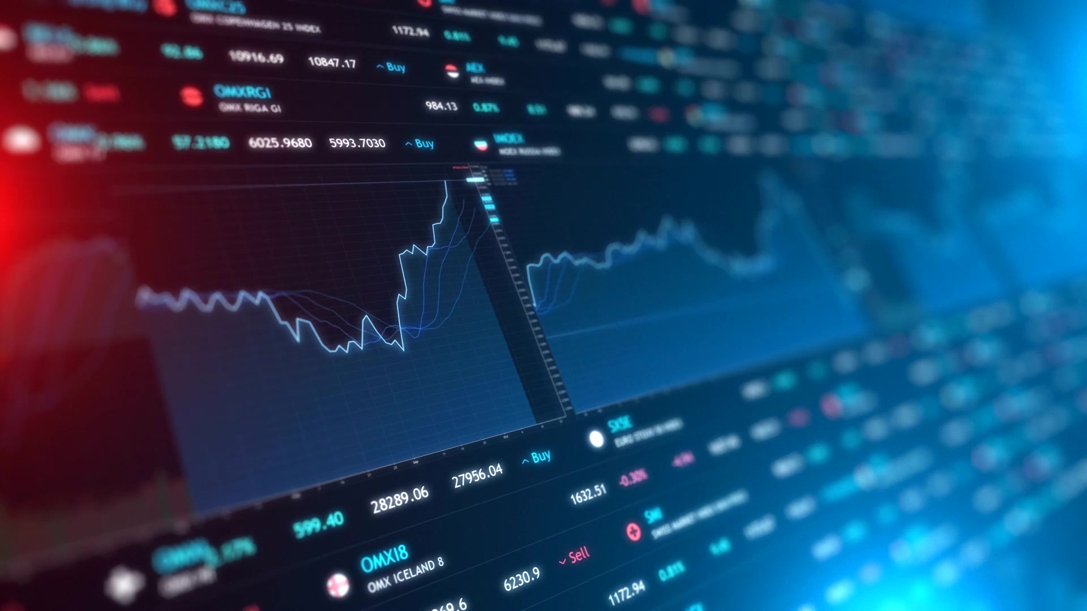
Cryptocurrency and money-laundering
Presented by Anna Piliavska

Slide 2
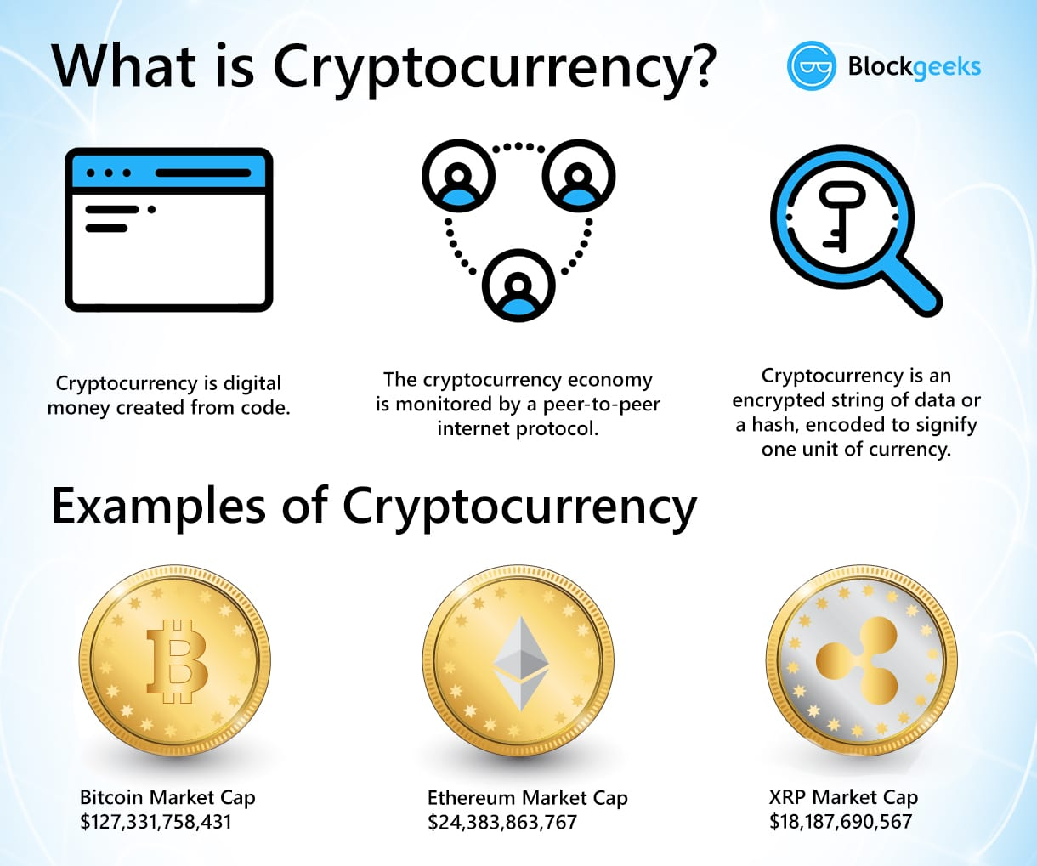
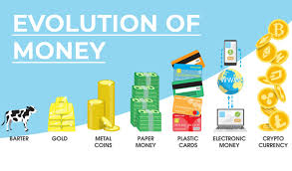
What is cryptocurrency?
According to investopedia, a cryptocurrency is a digital or virtual currency that is secured by cryptography, which makes it nearly impossible to counterfeit or double-spend. Many cryptocurrencies are decentralized networks based on blockchain technology—a distributed ledger enforced by a disparate network of computers. A defining feature of cryptocurrencies is that they are generally not issued by any central authority, rendering them theoretically immune to government interference or manipulation.

Slide 3

9 the most well-known cyprocurrencies
Bitcoin (BTC) - an original cryptocurrency created by Satoshi Nakamoto in 2009. BTC is “SHA-256” with coin limit of 21 million.
Litecoin (LTC) - a faster alternative to Bitcoin, launced in 2011. Unlike BTC, LTC being “scrypt” and has 84 million coin limit.
Ethereum (ETH) - created in 2015 cryptocurrency for application developers to pay for transaction fees and services on the Ethereum network.
Ripple (XRP) - released in 2012, acts as a cryptocurrency and a digital payment network for financial transactions. Unlike other currencies, it connects to the bank for moving sums of money on a larger scale.
Bitcoin Cash is an improved version of BTC with increased size of blocks, allowing more transactions to be processed faster.
Ethereum Classic runs smart contracts (applications that run exactly as programmed without any possibility of downtime, censorship, fraud or third-party interface). Like Ethereum, it provides a value token called “classic ether,” which is used to pay users for products or services.
Zcash (ZEC) is a private digital currency where users can send and receive Zcash without disclosing the sender, receiver or the amount transacted.
Stellar Lumen (XLM) is an intermediary currency that facilitates currency exchange. Stellar allows a user to send any currency they own to someone else in a different currency.
Bitcoin Satoshi’s Vision (Bitcoin SV) is the result of the 2018 split, or hard fork, of Bitcoin Cash. It is intended to more closely resemble the original purpose of Bitcoin, particularly decentralization and using cryptocurrency as payments.

Slide 4
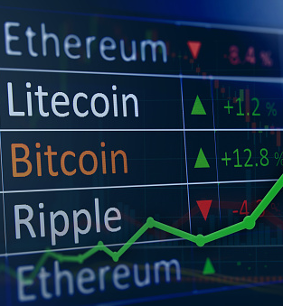
Risks for crypto users
Irreversible: After confirmation, a transaction cannot be reversed, there is no safety net.
Anonymous Neither transactions nor accounts are connected to real-world identities, everything is digitalized with access by means of the internet.
Global Speed: Transaction are nearly instant in the network and are confirmed in a couple of minutes. Since they happen in a global network of computers, they are completely indifferent of your physical location. There are no third parties involved in verification or validation.
Secure: Strong cryptography and the magic of big numbers makes it impossible to break this scheme.
No Gatekeeper: The software that everybody can download is for free. After you installed it, you can receive and send Bitcoins or other cryptocurrencies.

Slide 5
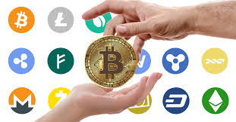
Statistics on crypto money-laundering
According to Forbes, it is estimated that only 1.1% of all cryptocurrency transactions are illicit.
However, during its early days, Bitcoin was widely associated with the Silk Road, an online dark-net marketplace, where users could purchase weapons and illegal drugs anonymously.

Slide 6

Chanpeng Zhao “CZ”, the Founder & CEO of Binance, largest cryptocurrency exchange by volume in the world on the volume of illicit transactions in crypto versus fiat?
"It’s probably a thousand times less. Basically, for any meaningful amount of money you want to move in the crypto, it is very hard to move it anonymously. There are third-party monitoring tools, and databases that can match many of the addresses to known persons. The cryptocurrency market cap is so small, that if you are moving a $100 million dollars, you cannot do so without going through a centralized exchange, making it even easier to track."

Slide 7
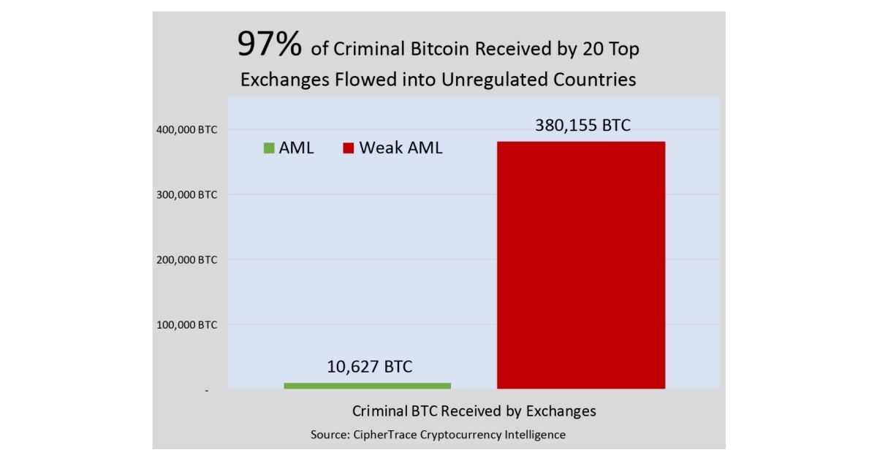
BUT!!!
Cryptocurrency research group CipherTrace conducted an analysis of 45 million transactions from the top 20 cryptocurrency exchanges globally.
The data, which spans from January 2009 to September 2018, indicates 97 percent of the Bitcoin laundered through top exchanges ends up in countries with lenient AML regulations.

Slide 8
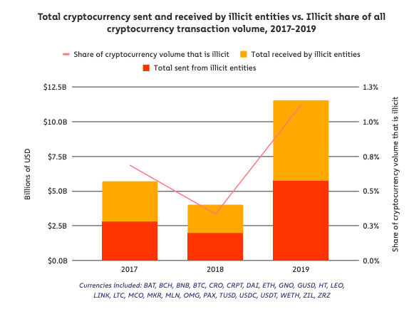
Laundering BTC is easy on unregulated exchanges
CipherTrace found criminals have laundered approximately 380,000 BTC ($2.5 billion), and 97 percent of the Bitcoin criminals send for laundering is to unregulated cryptocurrency exchanges.

Slide 9
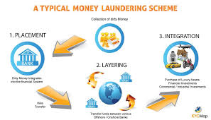
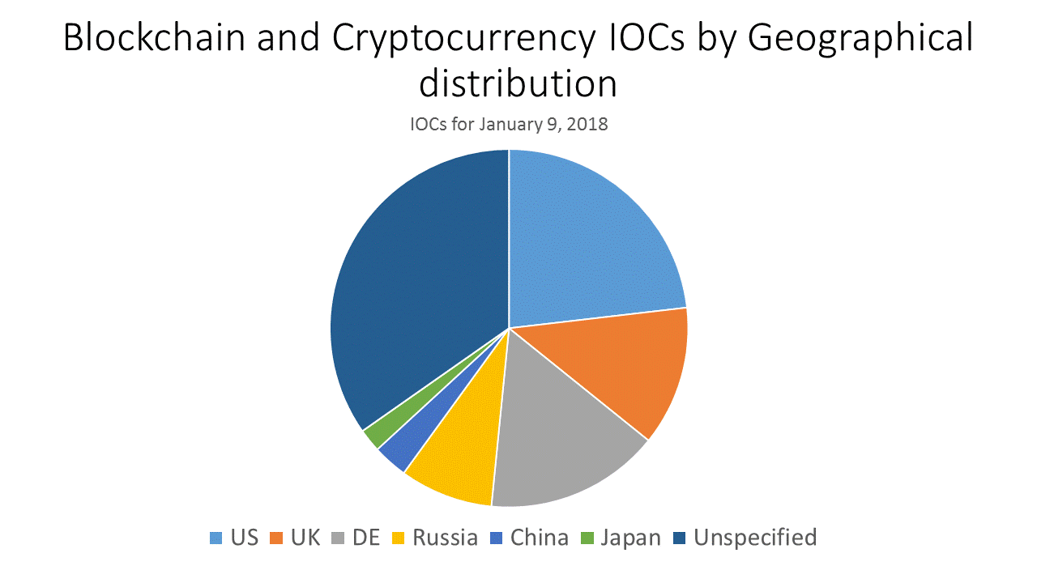
Common Crypto Money Laundering Practices
Unregulated Exchanges
Tumblers
Prepaid Cards
Gaming Sites
ATMs
P2P

Slide 10
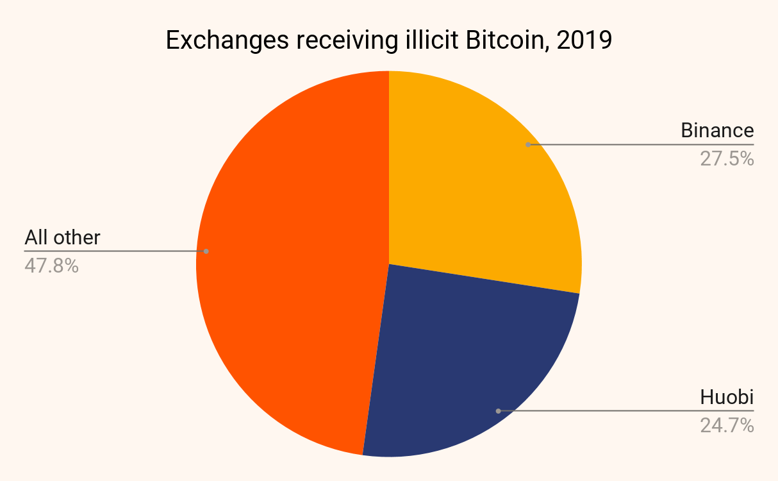
Moreover, according to a recent report from Cointelegraph, Binance is being sued by the current owners of Zaif, a Japanese cryptocurrency exchange, which was hacked in 2018. The plaintiffs allege that Binance’s weak KYC requirements facilitated the laundering of $60 million stolen from the exchange.

Slide 11

A case involving millions of dollars in bitcoin and Western Union payments has resulted in New York State’s first conviction for cryptocurrency money laundering.
Callaway Crain and Mark Sanchez, both 35, laundered $2.8 million earned through sales of controlled substances carried out over the internet.
Between 2013 and 2018, the two men sold steroids and other drugs including Viagra across the U.S. via their website “NextDayGear” and on the dark web. They sold over 10,000 packages and accepted payments in cryptocurrency and fiat currency via Western Union, which they then laundered.
Customers usually paid in bitcoin, the Attorney’s Office said, with the defendants laundering the proceeds via one or more “intermediary” cryptocurrency wallets to obfuscate the source of the funds. The bitcoin was then converted to U.S. dollars using a cryptocurrency exchange platform before the cash was deposited into their bank accounts.
Western Union payments, on the other hand, were laundered through the use of false identities or international wire transfers from receivers outside of the U.S.
The duo has now pleaded guilty and faces a jail term of 2.5–7.5 years, with sentencing expected to take place on July 12, 2019.

Slide 12
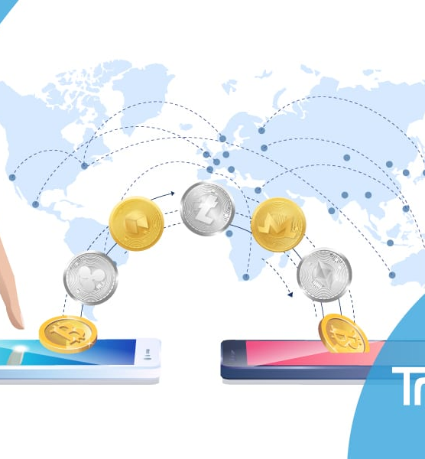
US and global approaches to crypto
Globally, AML enforcement, when it comes to cryptocurrency transactions, varies widely – from relatively strict regulations in the UK, Netherlands, and much of Europe to practically non-existent enforcement in other countries. In June, 2019, the Financial Action Task Force (FATF) issued a global requirement for cryptocurrency-related businesses to collect and share customer identities for each transaction, known as the Travel Rule.

Slide 13
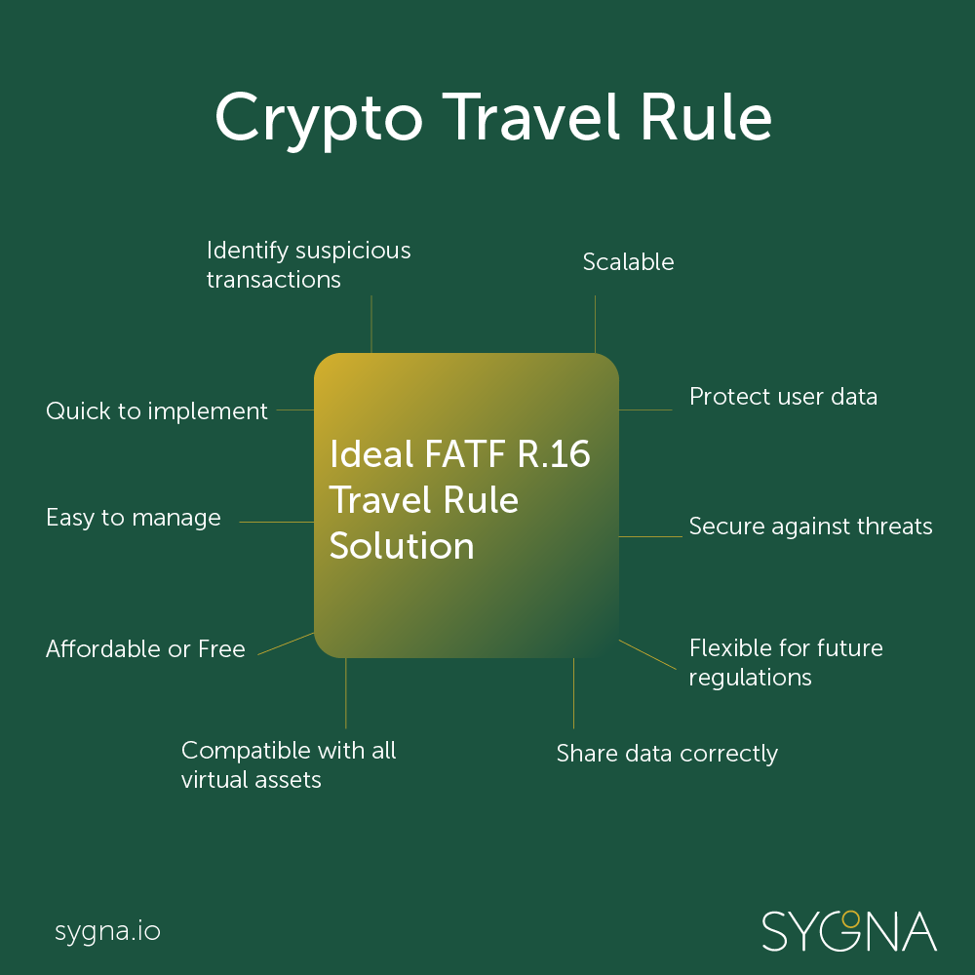
The Travel Rule (cont.)
The Travel Rule requires crypto exchanges to pass information about their customers to one another when transferring funds between firms. Member countries have one year to implement FATF guidelines (with a planned review set for June of next year).
The issuance was an effort by FATF to cut down on money laundering and funding of terrorist organizations.

Slide 14
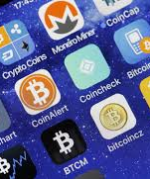
US Legal considerations on crypto investing
The IRS has defined cryptocurrencies as property, rather than as currencies proper. This means that individual investors are beholden to capital gains tax laws when it comes to reporting their cryptocurrency expenses and profits on their annual tax returns, regardless of where they purchased digital coins.
According to a report by CNBC, "anyone with more than $10,000 abroad usually needs to fill out the Report of Foreign Bank and Financial Accounts (FBAR)...with the Treasury Department each year. Another law--the Foreign Account Tax Compliance Act, or FATCA--requires certain U.S. taxpayers to describe their overseas accounts on Form 8938, when they file their taxes with the IRS."

Slide 15
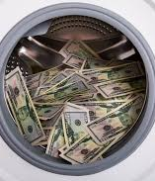
Combating the virtual threat
To increase regulatory scrutiny!
To thoroughly understand the virtual currency system because the solutions to stopping money laundering will likely emerge from innovations within the industry.
To educate fraud examiners and others who fight money laundering in the virtual currency world, thus, these same technologies would turn the tables on money launderers and others who perpetrate fraud.

Slide 16

Questions?

